Slide 1


Slide 2
What is CloudHour?
Objective of CloudHour
Round-table discussion
Focus on a few key topics
Why It's Important
Rapid changes in cloud security and tech
Stay updated and connected for growth as community
How it will benefit the community
Real-time engagement with hosts and community members
Ask open questions and speak your opinion
Opportunity to affect the next agenda
Notes:
Objective of CloudHour
The objective of CloudHour is to create a collaborative space where professionals can come together to discuss, learn, and share insights on the most pressing topics in cloud security and modern workplace technology.
Why its important
CloudHour is important because, in the rapidly evolving landscape of cloud security and workplace technologies, staying updated and connected is crucial for career growth and organizational resilience
How it will benefit the community
By attending CloudHour, community members will have the unique opportunity to engage with industry experts in real-time, ask questions, network with like-minded professionals, and even have the chance to contribute their own expertise by becoming guest speakers in future episodes.

Slide 3

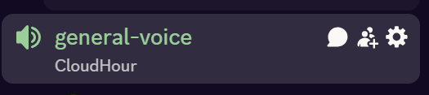
If you prefer to not talk or be asked questions press mute
press mute just mute the mic
If you preferer to chat press

Slide 4
Links to share
Introduction to Microsoft Entra External ID deployment guide
Analyze Conditional Access Policy Impact
ASR Rule Inspector
New user experience for consumer authentication
New innovations in Microsoft Entra to strengthen AI security and identity protection
Notes:
https://learn.microsoft.com/en-us/entra/architecture/deployment-external-intro
https://learn.microsoft.com/en-us/entra/identity/conditional-access/concept-conditional-access-report-only
https://rksolutions.nl/asr-rules-the-importance-of-configuration-and-verifying-with-the-asr-rule-inspector/
https://techcommunity.microsoft.com/blog/microsoft-entra-blog/new-user-experience-for-consumer-authentication/3822035
https://techcommunity.microsoft.com/blog/microsoft-entra-blog/new-innovations-in-microsoft-entra-to-strengthen-ai-security-and-identity-protec/3827393

Slide 5
Agenda
Restricted Management Admin Units (RMAU)
Windows Autopatch for Business Premium / EDU
Global Secure Access Community
Expansions to Windows LAPS
Quick machine recovery in Windows

Slide 6
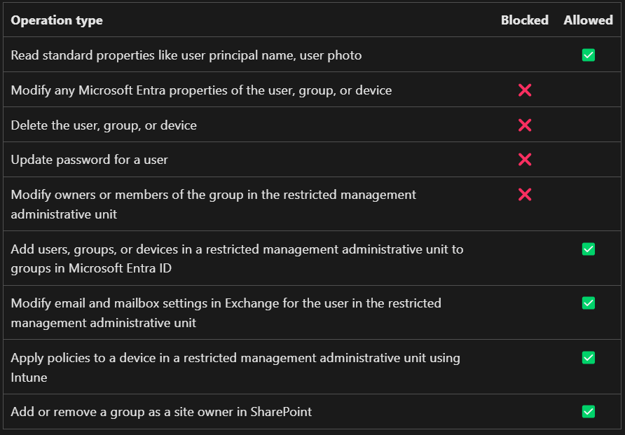
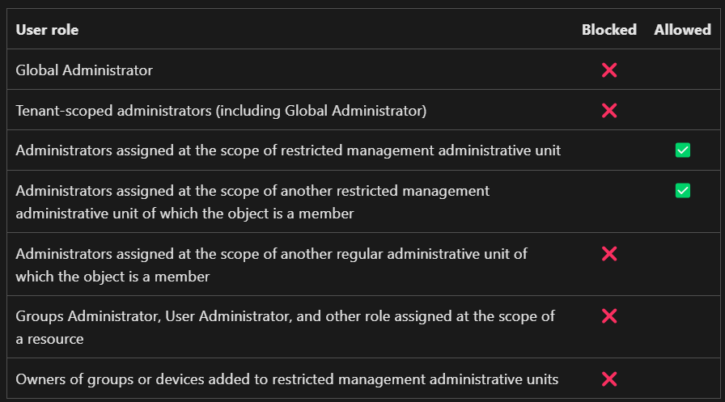
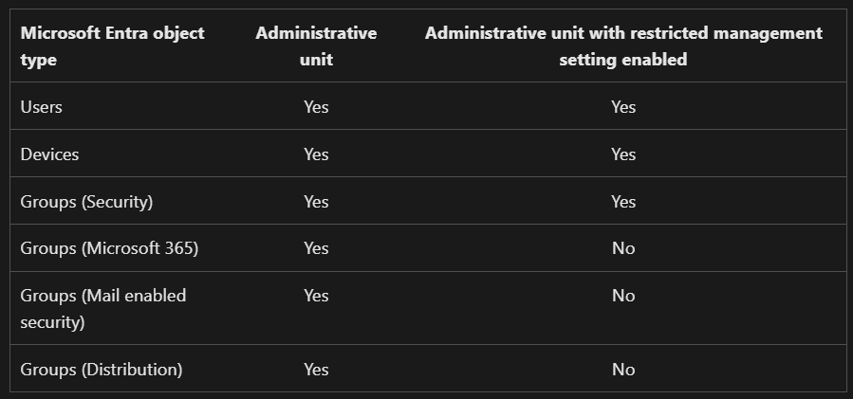
Restricted Management Admin Units (RMAU)
Notes:
https://learn.microsoft.com/en-us/entra/identity/role-based-access-control/admin-units-restricted-management

Slide 7
Windows Autopatch for Business Premium / EDU
Why Windows Autopatch Is the Smart Update Solution
Automates software updates across your organization
Centralizes and simplifies update management through Microsoft Intune
Included in Windows volume licensing and Microsoft CSP subscriptions
No extra cost to use, already part of your plan
What Makes Windows Autopatch Different?
Combines tools like the former Windows Update for Business deployment service
Intelligent cloud-based automation for updates
Already used by thousands of organizations
Notes:
https://techcommunity.microsoft.com/blog/windows-itpro-blog/why-windows-autopatch-is-the-smart-update-solution/4399200

Slide 8
Global Secure Access Community
Brought to you by the Global Secure Access Customer Engineering Team
Quick access URL: aka.ms/GlobalSecureAccessCommunity
Focused on Microsoft’s Security Service Edge (SSE) solution:
Microsoft Entra Internet Access
Microsoft Entra Private Access
Notes:
https://microsoft.github.io/GlobalSecureAccess/

Slide 9
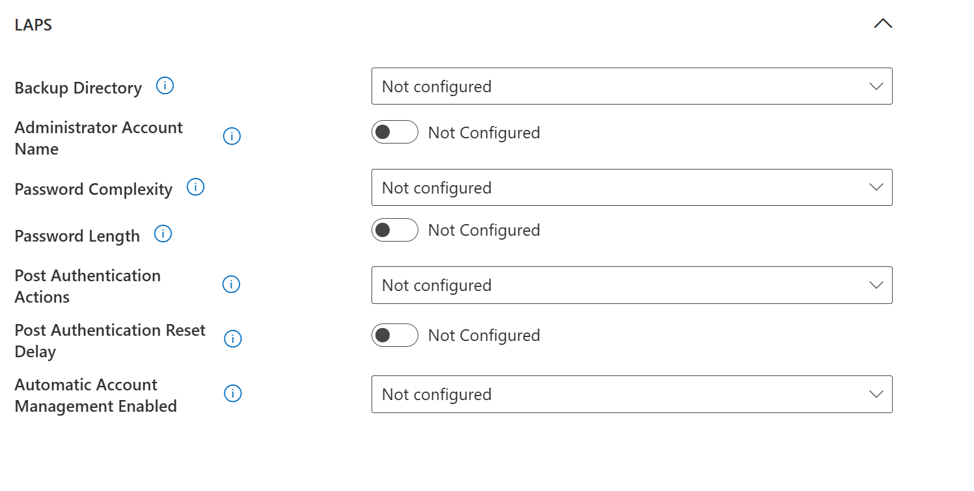
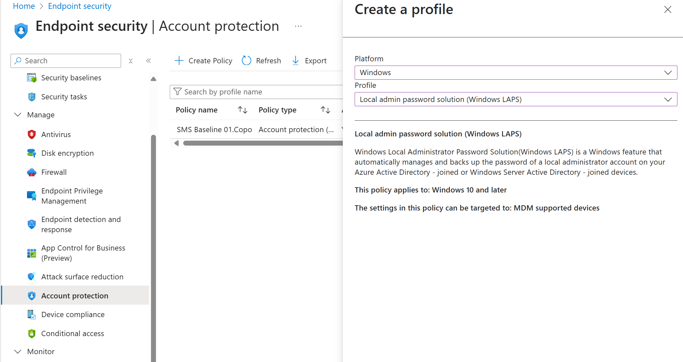
Expansions to Windows LAPS

Slide 10
Quick machine recovery in Windows
Quick Machine Recovery Overview
Automatically detects, diagnoses, and fixes critical boot issues in Windows 11.
Available in Windows Insider Preview Beta Channel (Windows 11, version 24H2).
Announced at Microsoft Ignite 2024 as part of Windows Resiliency Initiative.
Benefits for IT Administrators
Reduces manual troubleshooting efforts for boot failures.
Automates fixes via Windows Recovery Environment (Windows RE).
Quickly restores productivity during widespread outages.
Notes:
https://techcommunity.microsoft.com/blog/windows-itpro-blog/get-started-with-quick-machine-recovery-in-windows/4398487

Slide 11
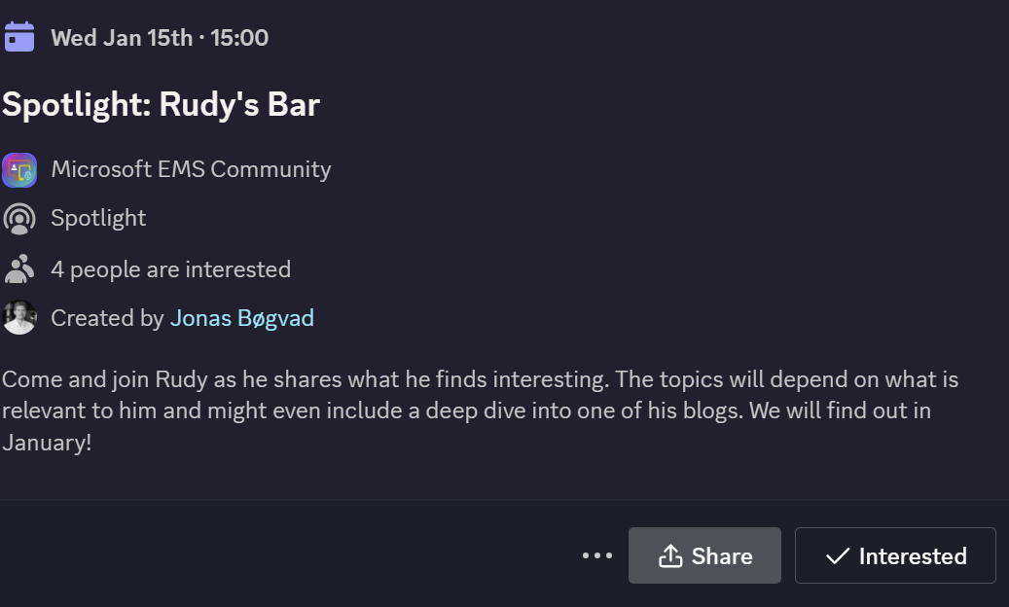
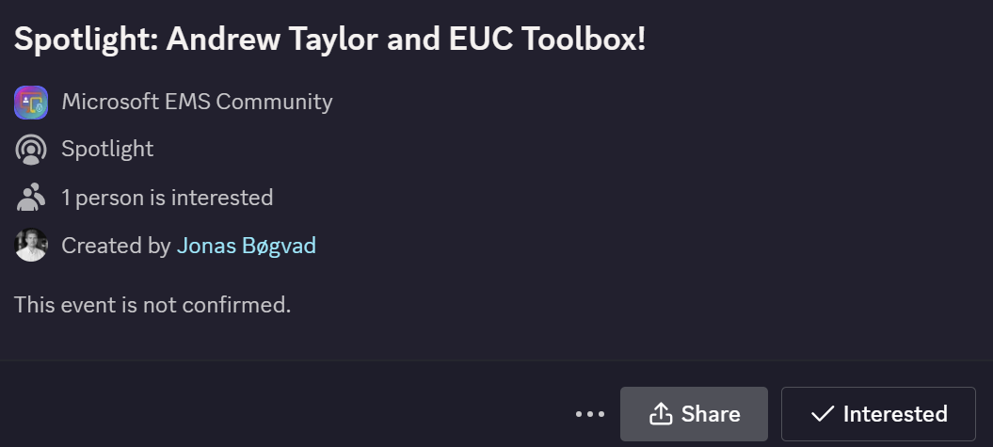
Spotlights sessions
OSD Cloud​
IntuneCD​ (awaiting confirmation on date)
Rudy Webinar ​
Johan Arwidmark ​
Purav (In contact)
Kelvin from CIPP ​
Andrew Taylor and EUC Toolbox (Confirmed)
TUGI tool (Confirmed)
Somesh Pathek (Confirmed)
WinTuner Stephan van Rooji (In contact)
IntuneCD Tobias (In contact)

Slide 12
Upcoming spotlight events!
Show in discord

